Slide 1

Mortgage Pooling Combinatorial Optimization Challenge
Mortgage Loan Insights/QUESTIONS
BY:
Apurwa Prasad
apurwa.prasad@uconn.edu

Slide 2
assessment DETAILS:
Initially started storing data on AWS S3 and due to technical issues (added to appendix) moved to Python.
Exploratory data analysis performed on Jupyter Notebook. (steps mentioned in attached Pdf file)
Used data for Visualizations:
Loan Result data (Cid-level, used Loan1 and LoanResult1 data, excluded constraints due to non-mortgage background)
Loan pool data (Loan-id level)

Slide 3
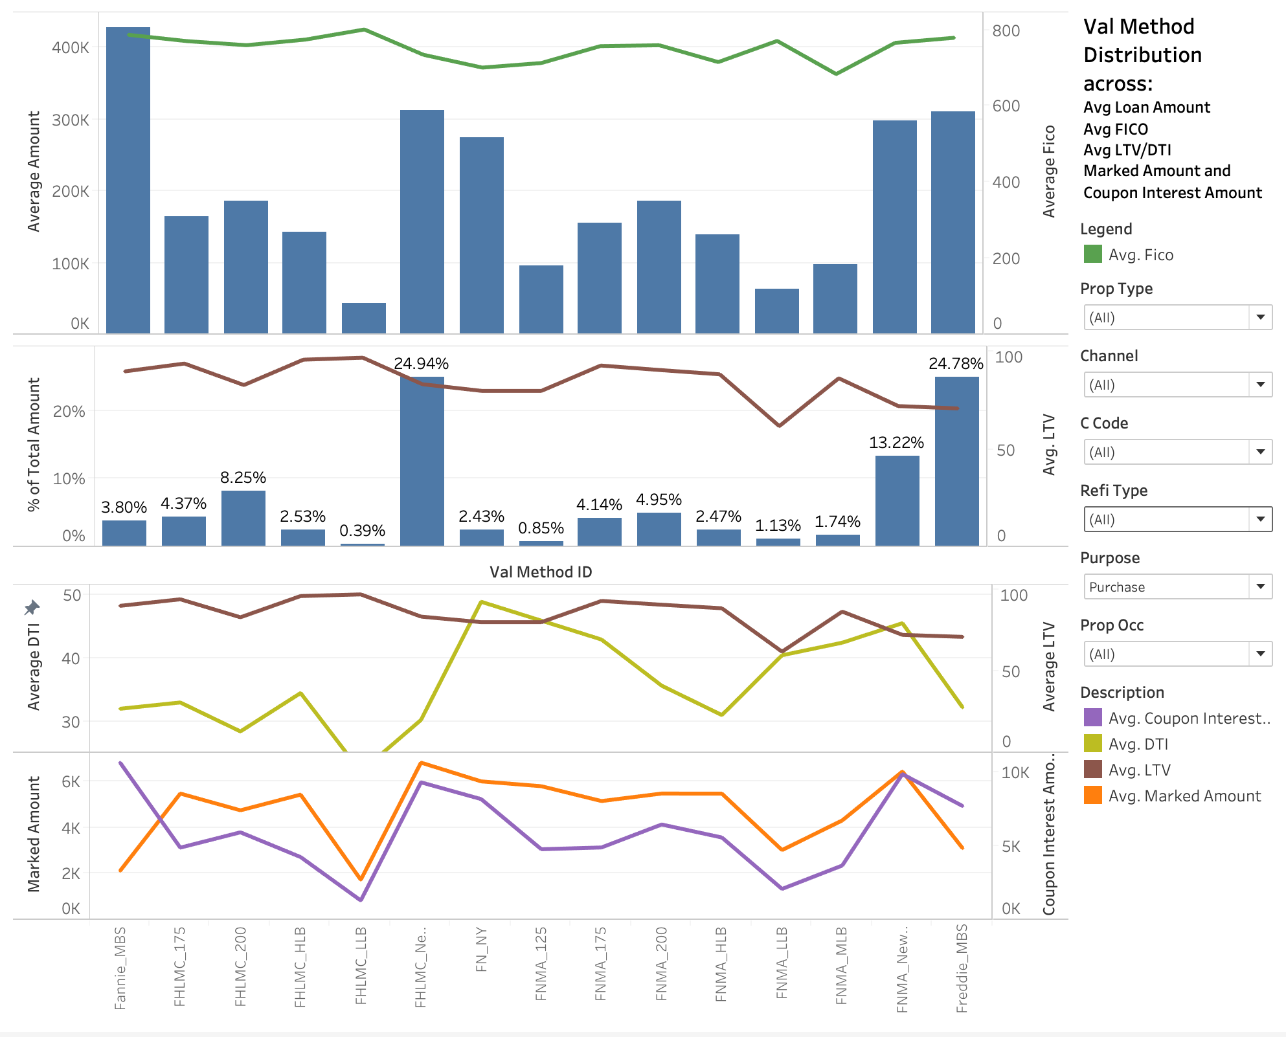
dASHBOARD 1 - At val method ID level (bASED ON LOAN RESULT DATA)

Slide 4
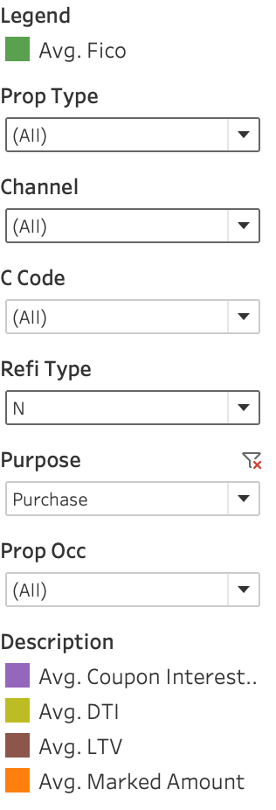
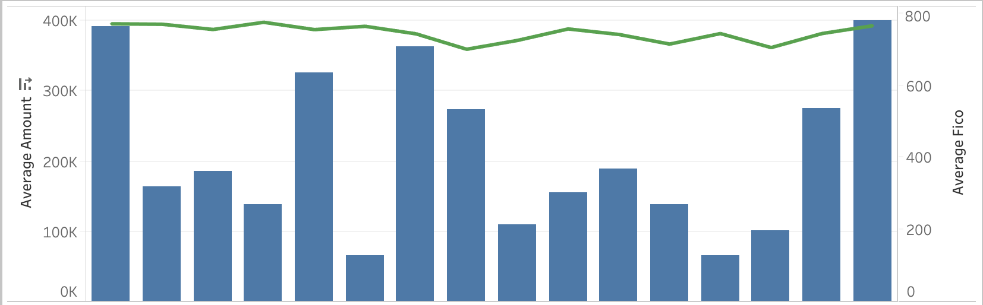
Highest average loan amount is for freddie_MBS and Fannie_MBS Highest avg fico score obsereved is for fhlmc_llb
For Refinance Type- N, Avg Loan Amount drops to ~$300k for Freddie MBS whereas for others(Cashout and RateTerm) it is more than ~$400k .

Slide 5
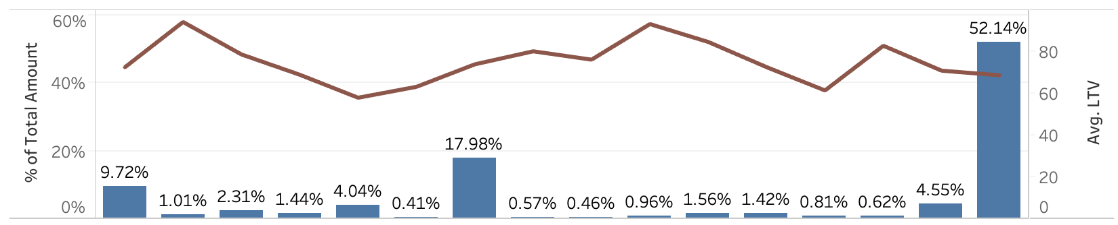
Fraddie_mbs consists 52% of the total loan amount
For Property Type: Condo ~ 77% of the Loan Amount belong to FHLMC_NewProd and Freddie_MBS
For Retail Channel, 36.44% of the Loan Amount belong to FHLMC_NewProd.
For Refinance Type- Cashout, 40.48% of the Loan Amount belong to FHLMC_NewProd.

Slide 6
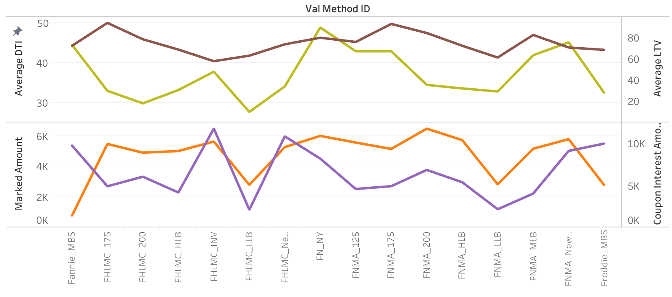
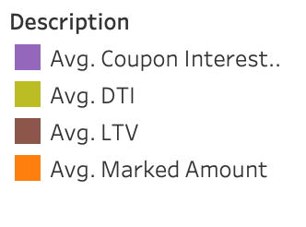
There is huge gap between avg ltv and avg dti for FHLMC_175 AND FHLMC_200
Average Coupon Interest Amount is observed highest for FHLMC_INV
Average Marked Amount is highest for FNMA_200
Marked amount – (Price * Loan Amount) / 100
Coupon Interest Amount = (1+ Coupon ) * Loan Amount)

Slide 7
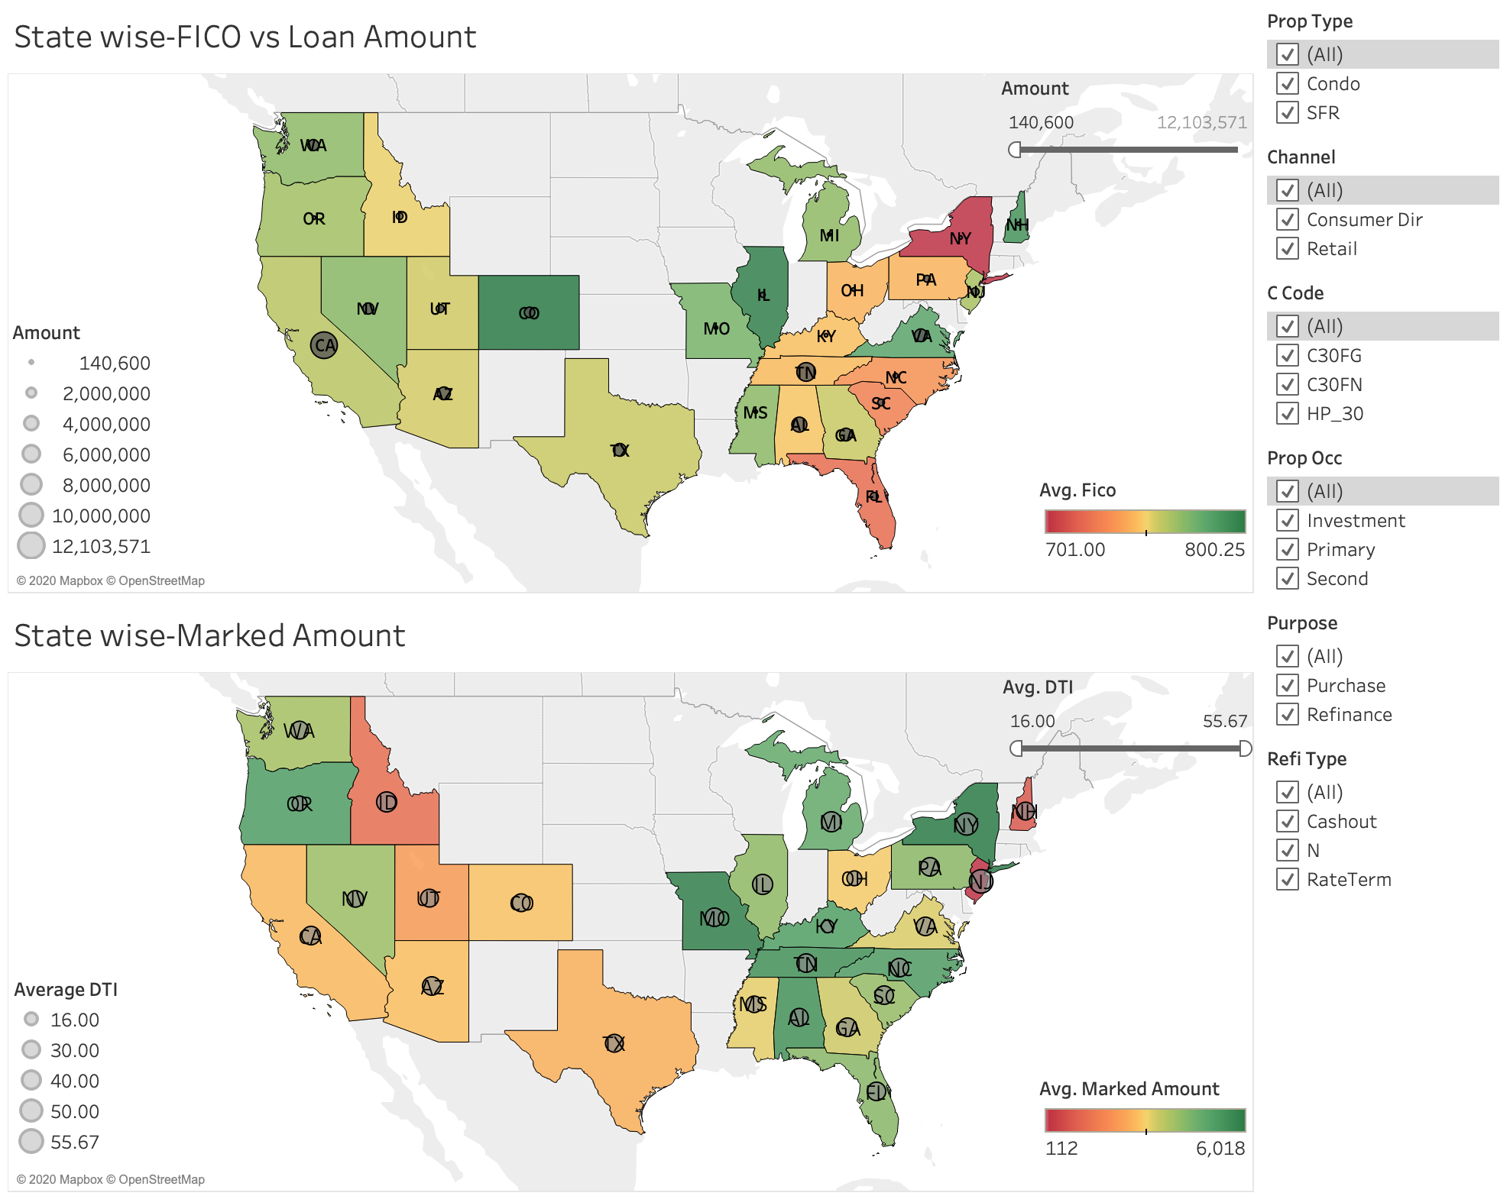
dASHBOARD 2 - At STATE level (bASED ON LOAN RESULT DATA)

Slide 8
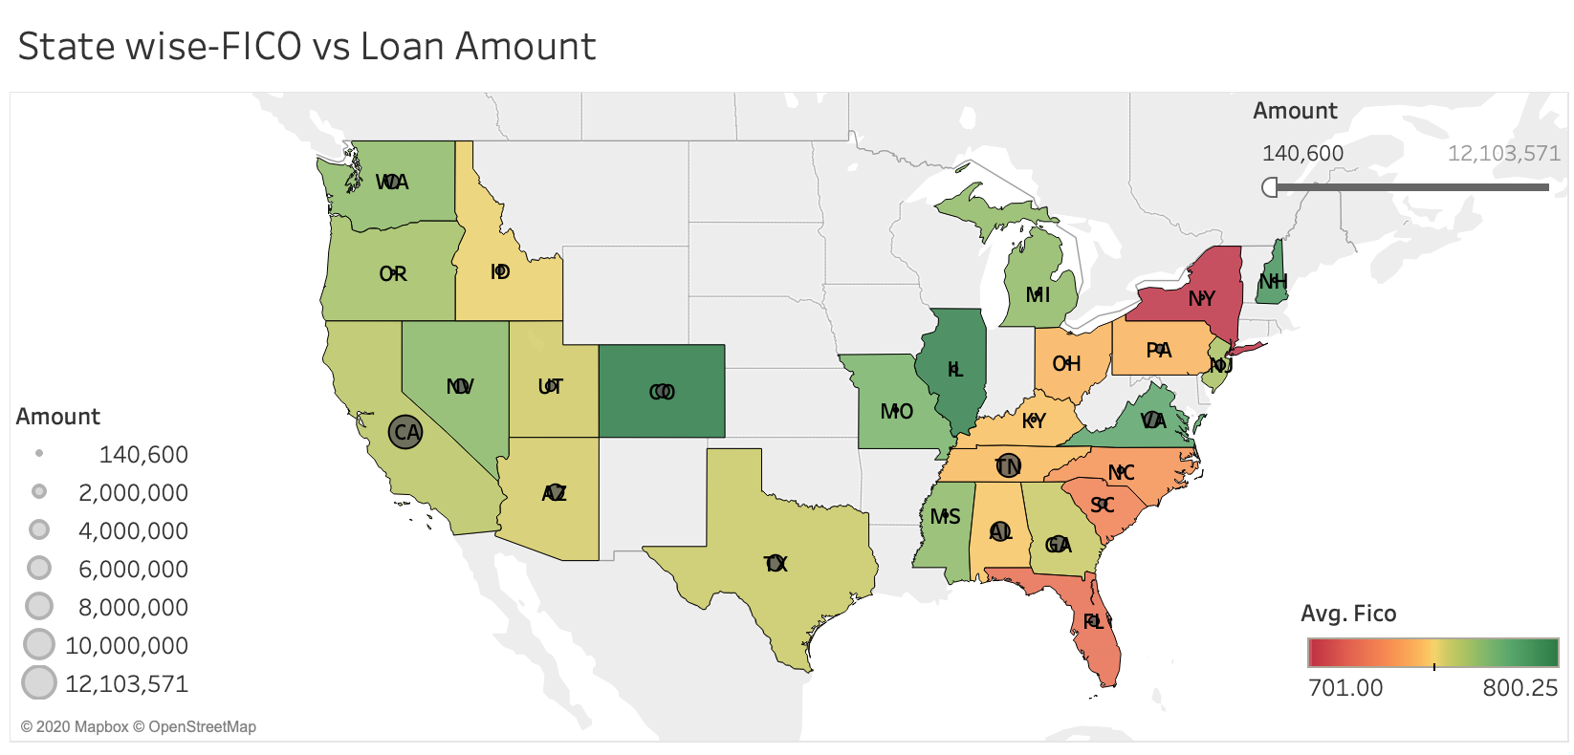
West coast comparatively has a higher range of FICO scores
Highest loan amount is observed in California, whereas the highest avg FICO score observed is in Colorado.

Slide 9
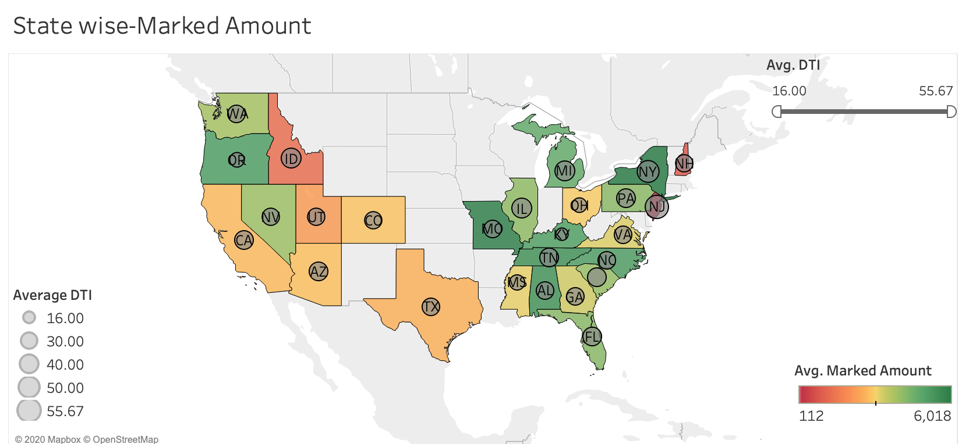
West coast comparatively has a Lower range of Marked Amount
NY and MO has the highest marked amount.
Average DTI score is homogeneously spread across states.

Slide 10
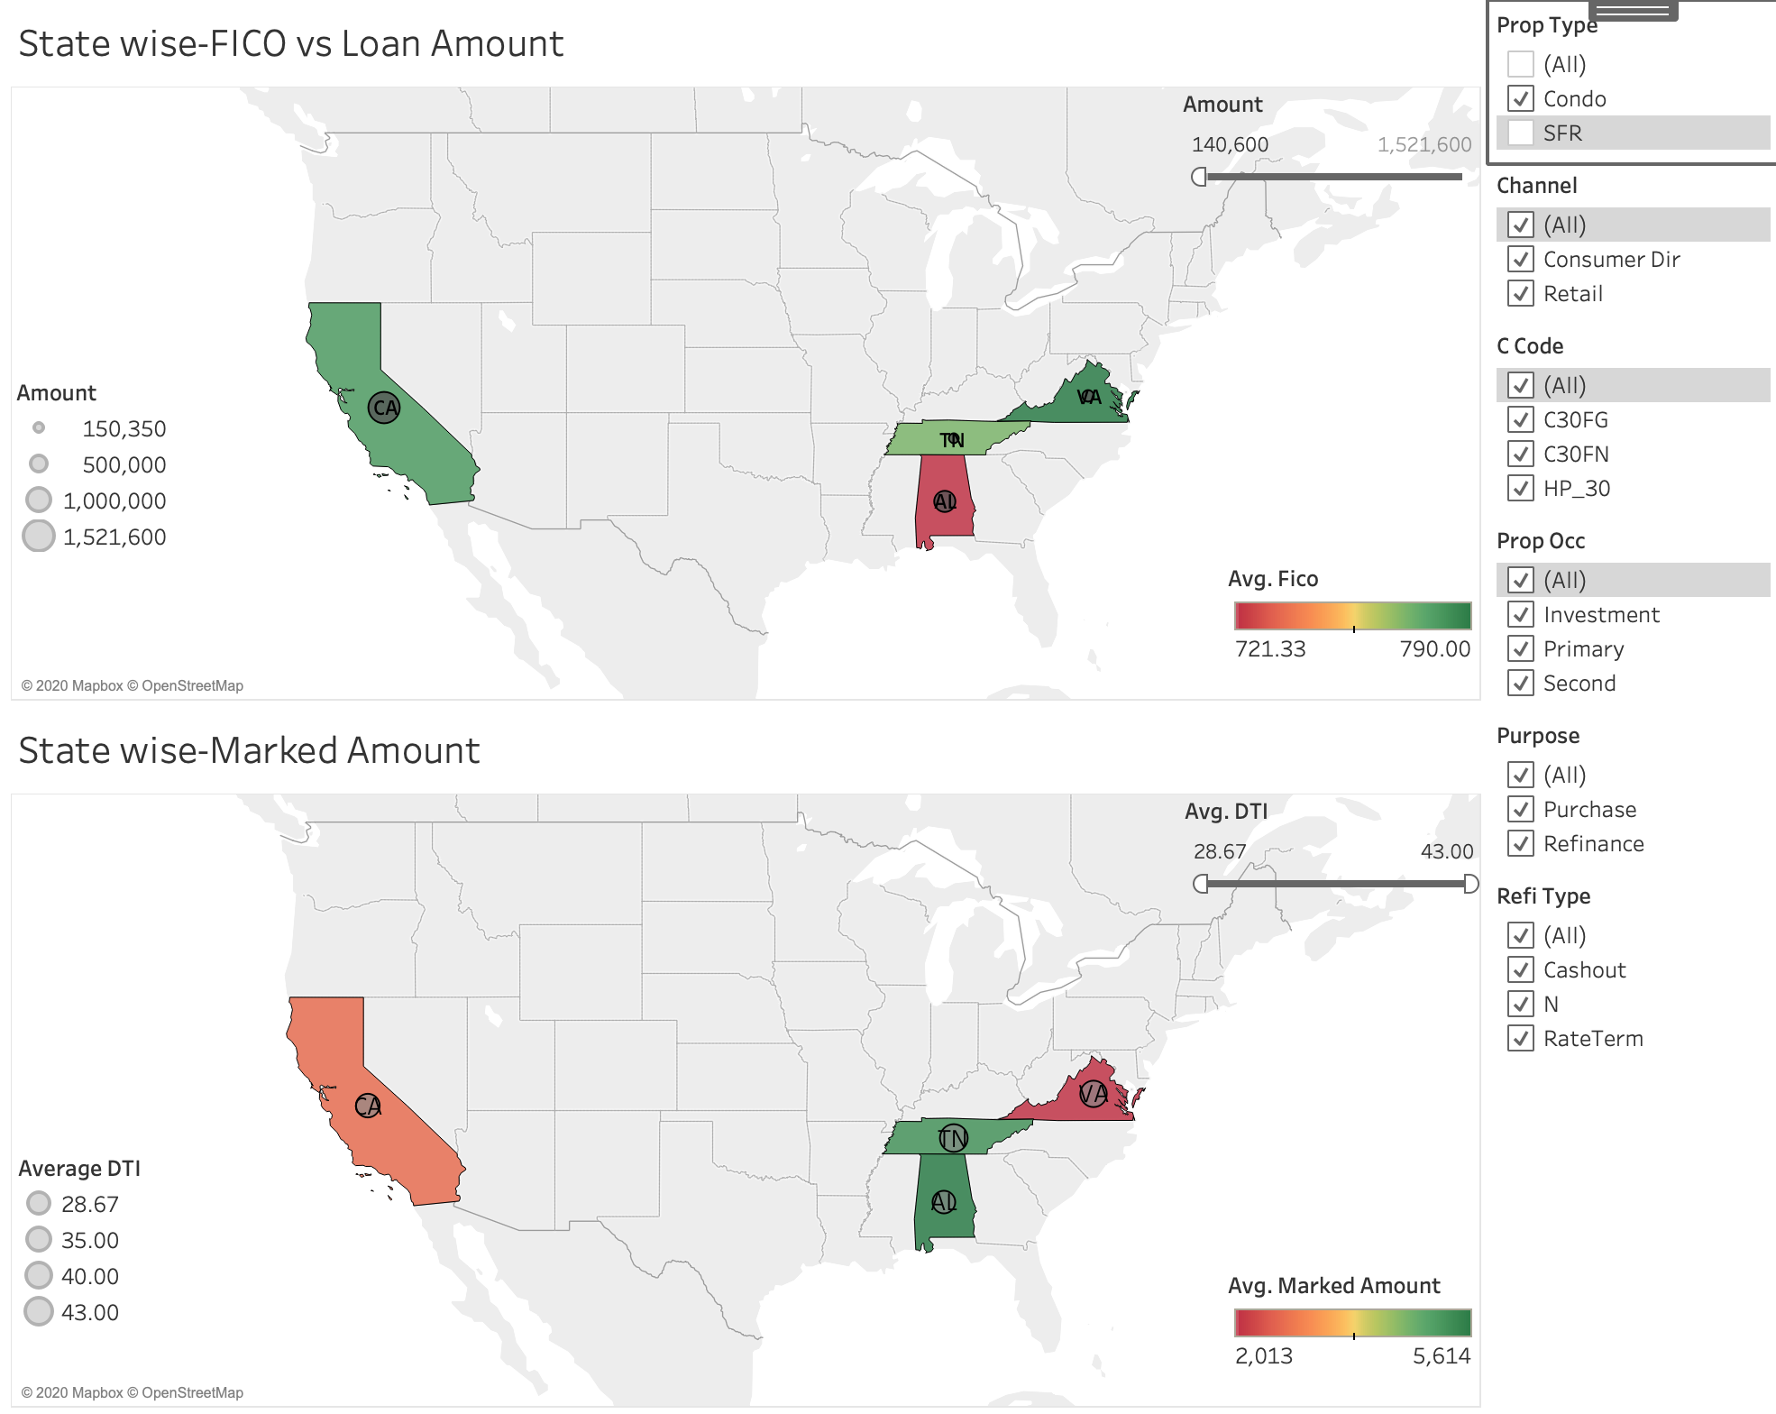
For property type as condo
It is only spread across CA, TN, AL and VA
VA has the maximum average FICO score and AL the minimum.

Slide 11
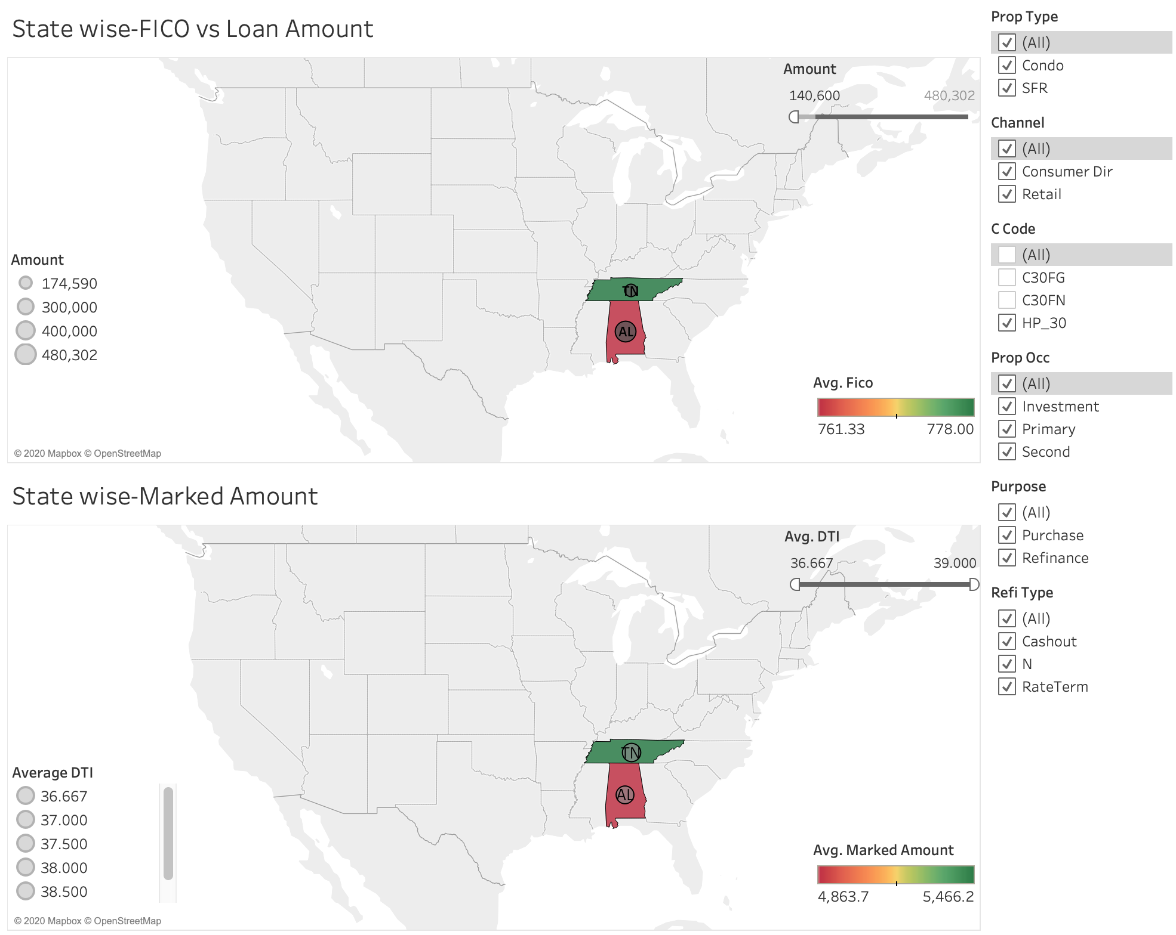
FOR C CODE HP 30:
It is only spread across TN, AL

Slide 12
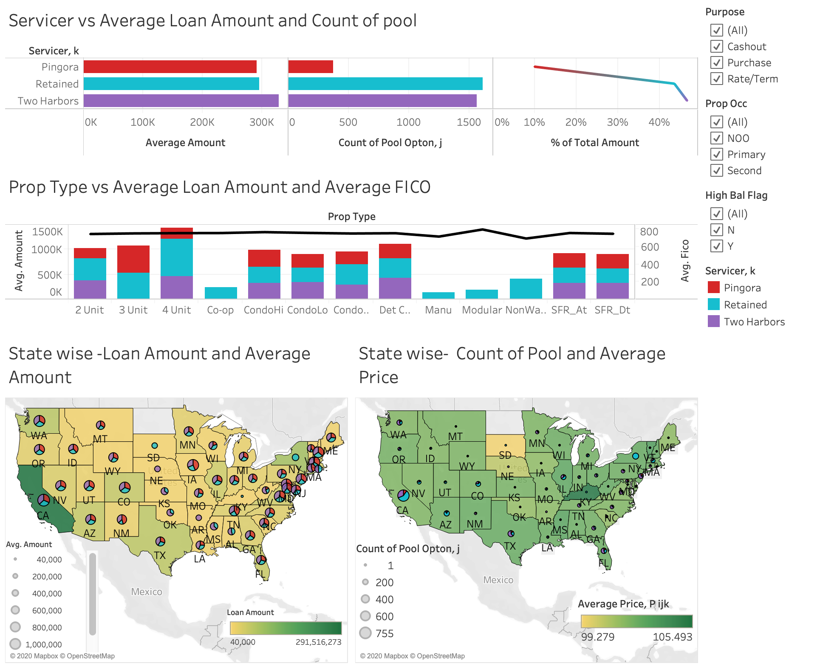
dASHBOARD 3 - At STATE level (bASED ON LOAN POOL DATA)

Slide 13
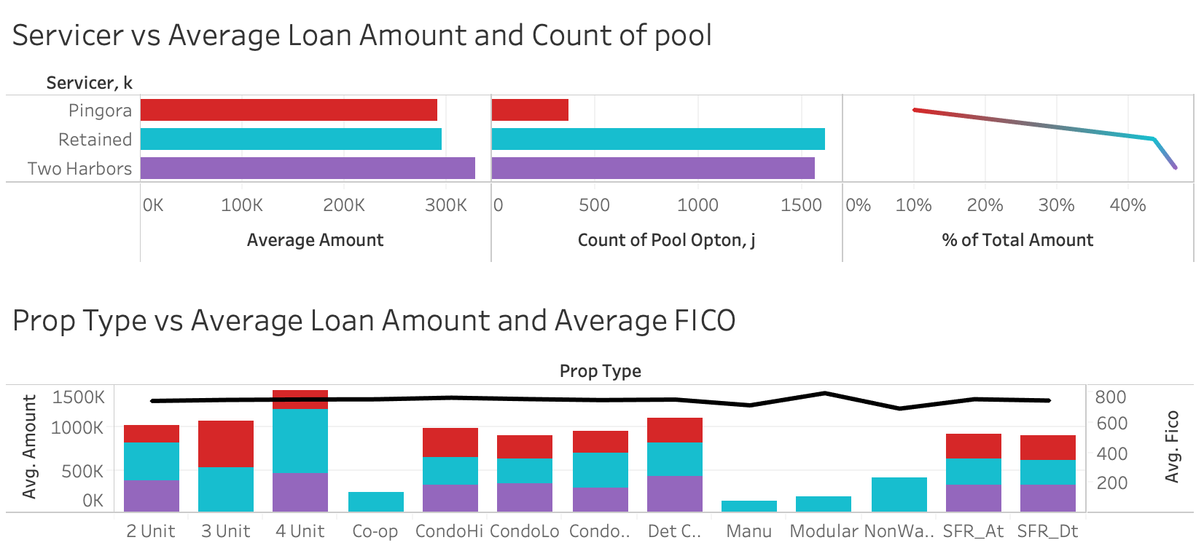
Pingora consists of only 10% of total loan amount
Two harbors does not have any loan record for 3-unit Property type.

Slide 14
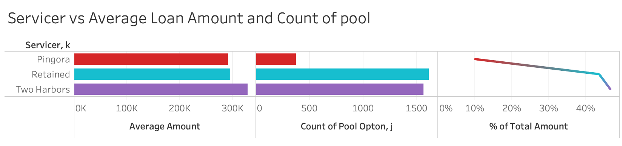
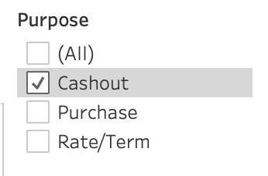
For Purpose-Cashout, Servicer Pingora has max Cashout for Average Loan Amount and max Count of pools

Slide 15
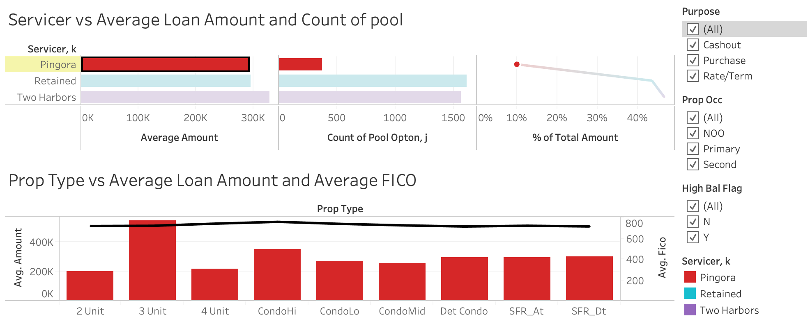
Average Loan Amount for Property Type-3 Unit is more than 2 Unit for Pingora

Slide 16
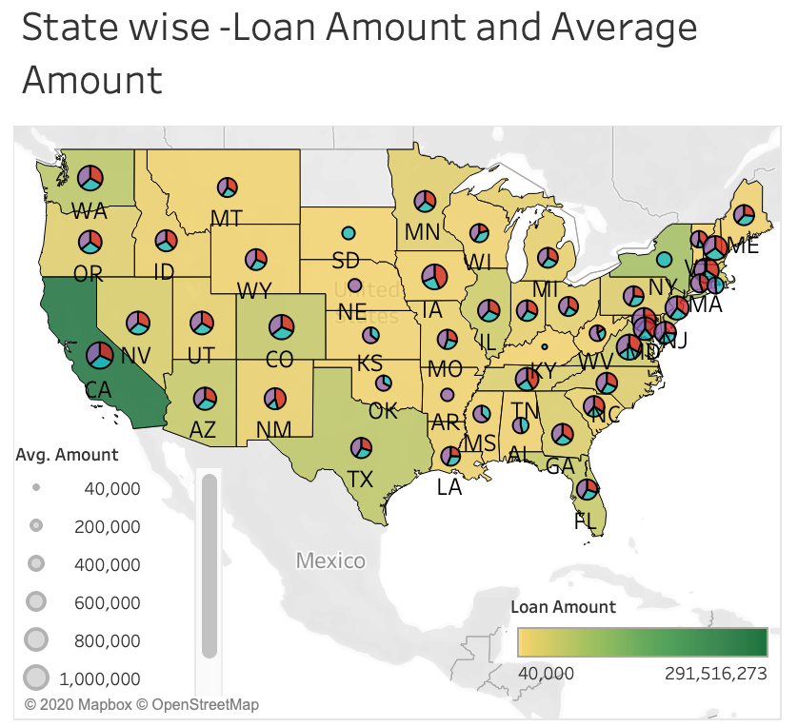
The Average Loan Amount are lowest in the mid region
California shows highest average Loan Amount.
Servicer Pingora is not available across mid region

Slide 17
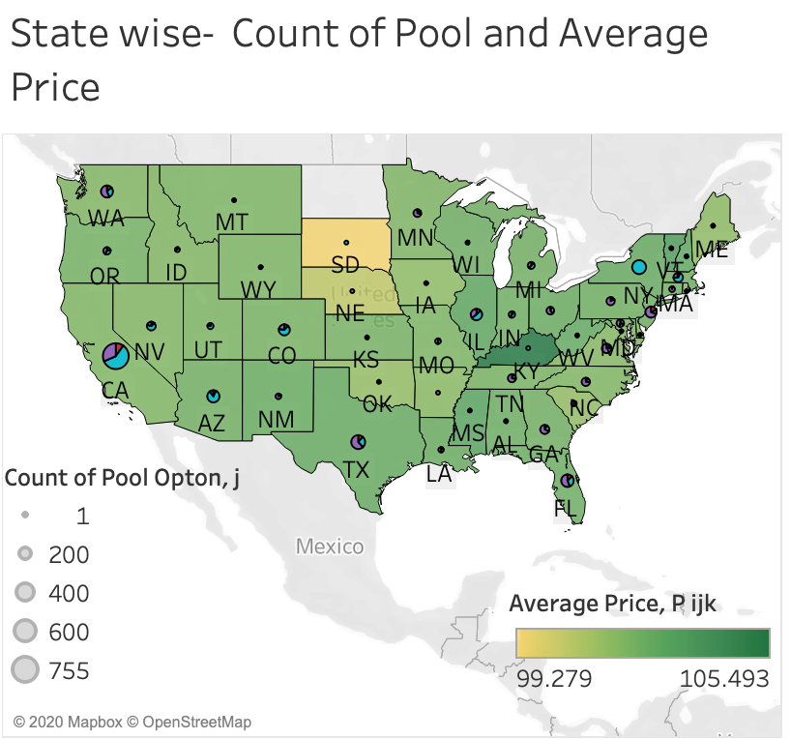
SD has min Average Price offered and max price offered in KY
Number of pools are greater in California
Servicer Pingora is not available across mid region

Slide 18
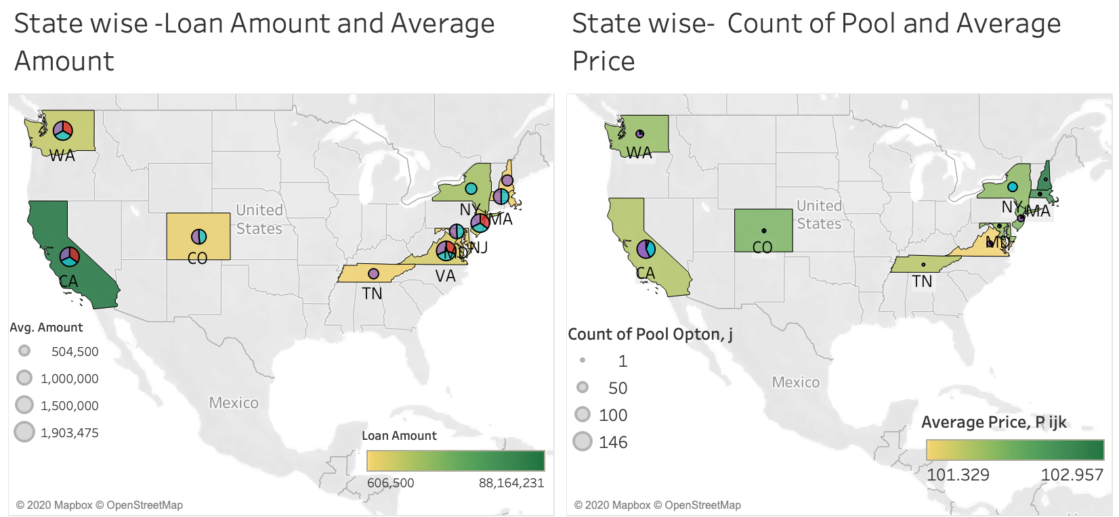
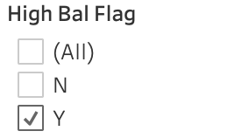
High balance account are spread across coastal areas.

Slide 19
Appendix
DATA structuring and querying

Slide 20
The Basic Steps for solving the assessment:
AWS S3 Storage
AWS Athena
Query Service
Tableau
Visualization
AWS S3
Step 1: Created IAM user for connecting to tableau and downloading keypair required to make connection between tableau and Athena.
Step 2: Creating bucket and uploading data
AWS Athena
Step 3: Creating database and tables for each folder given in the dataset
BI Tool Tableau
Step 4: Connect to AWS Athena. JDBC driver should be present in the system. Create dashboard and visualizations.

Slide 21
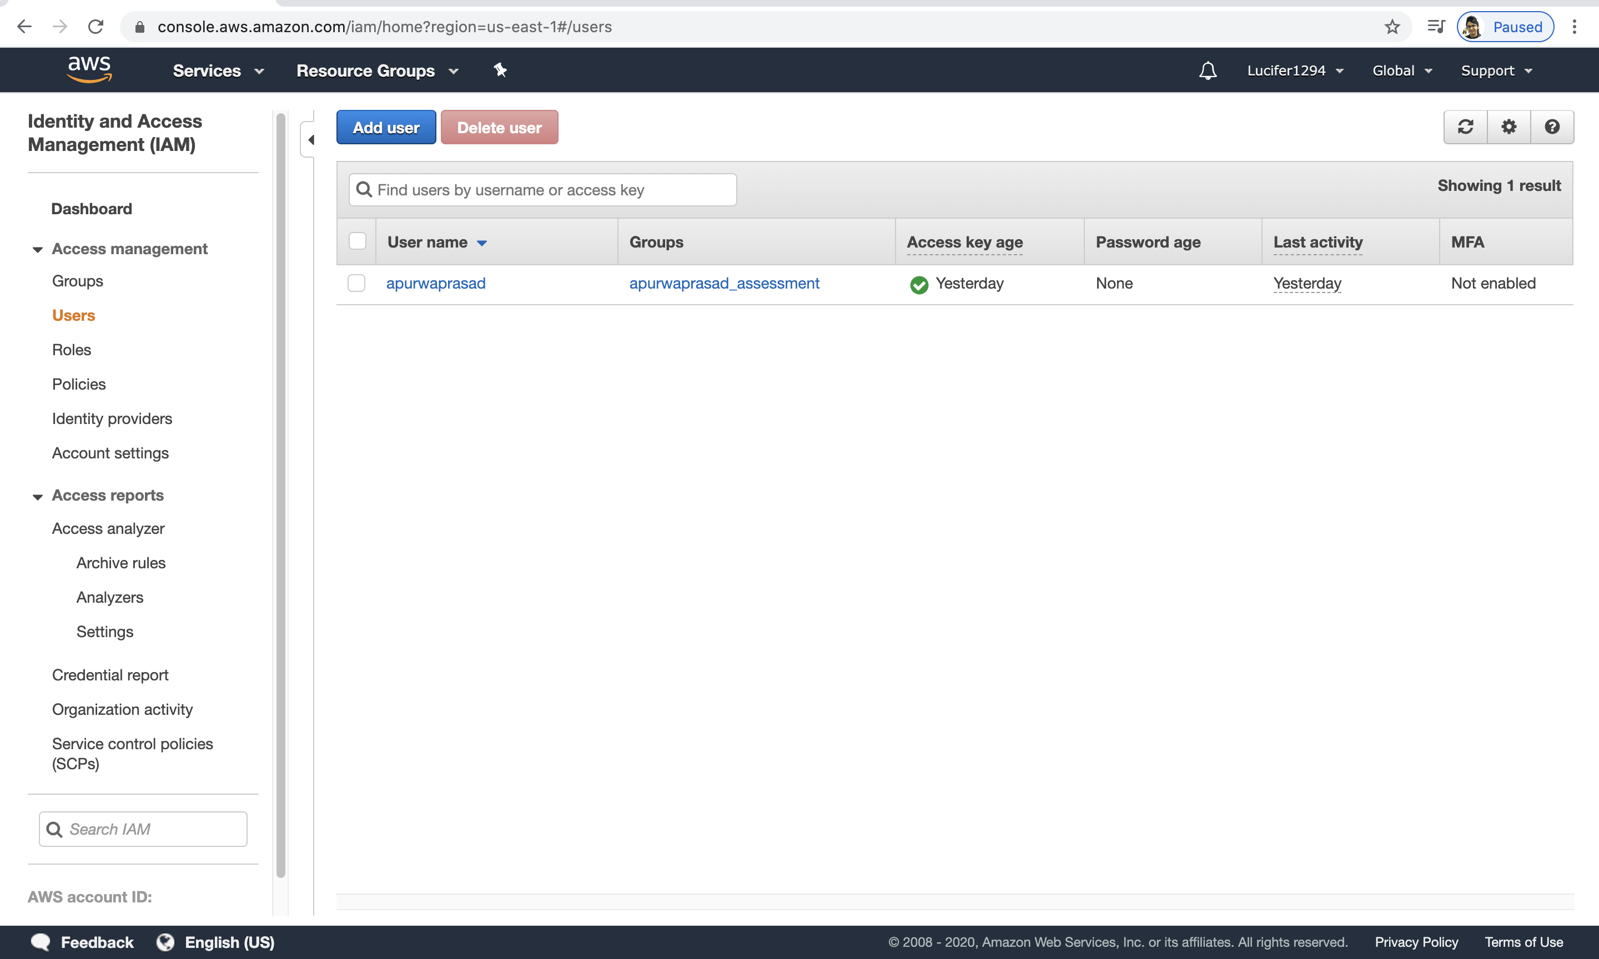
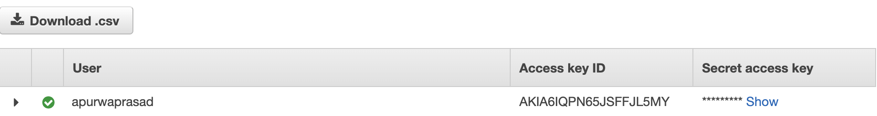
Step 1:
AWS S3
Created IAM user for connecting to tableau and downloading keypair required to make connection between tableau and Athena.
Downloaded keypair for configuring tableau connection with AWS Athena.

Slide 22
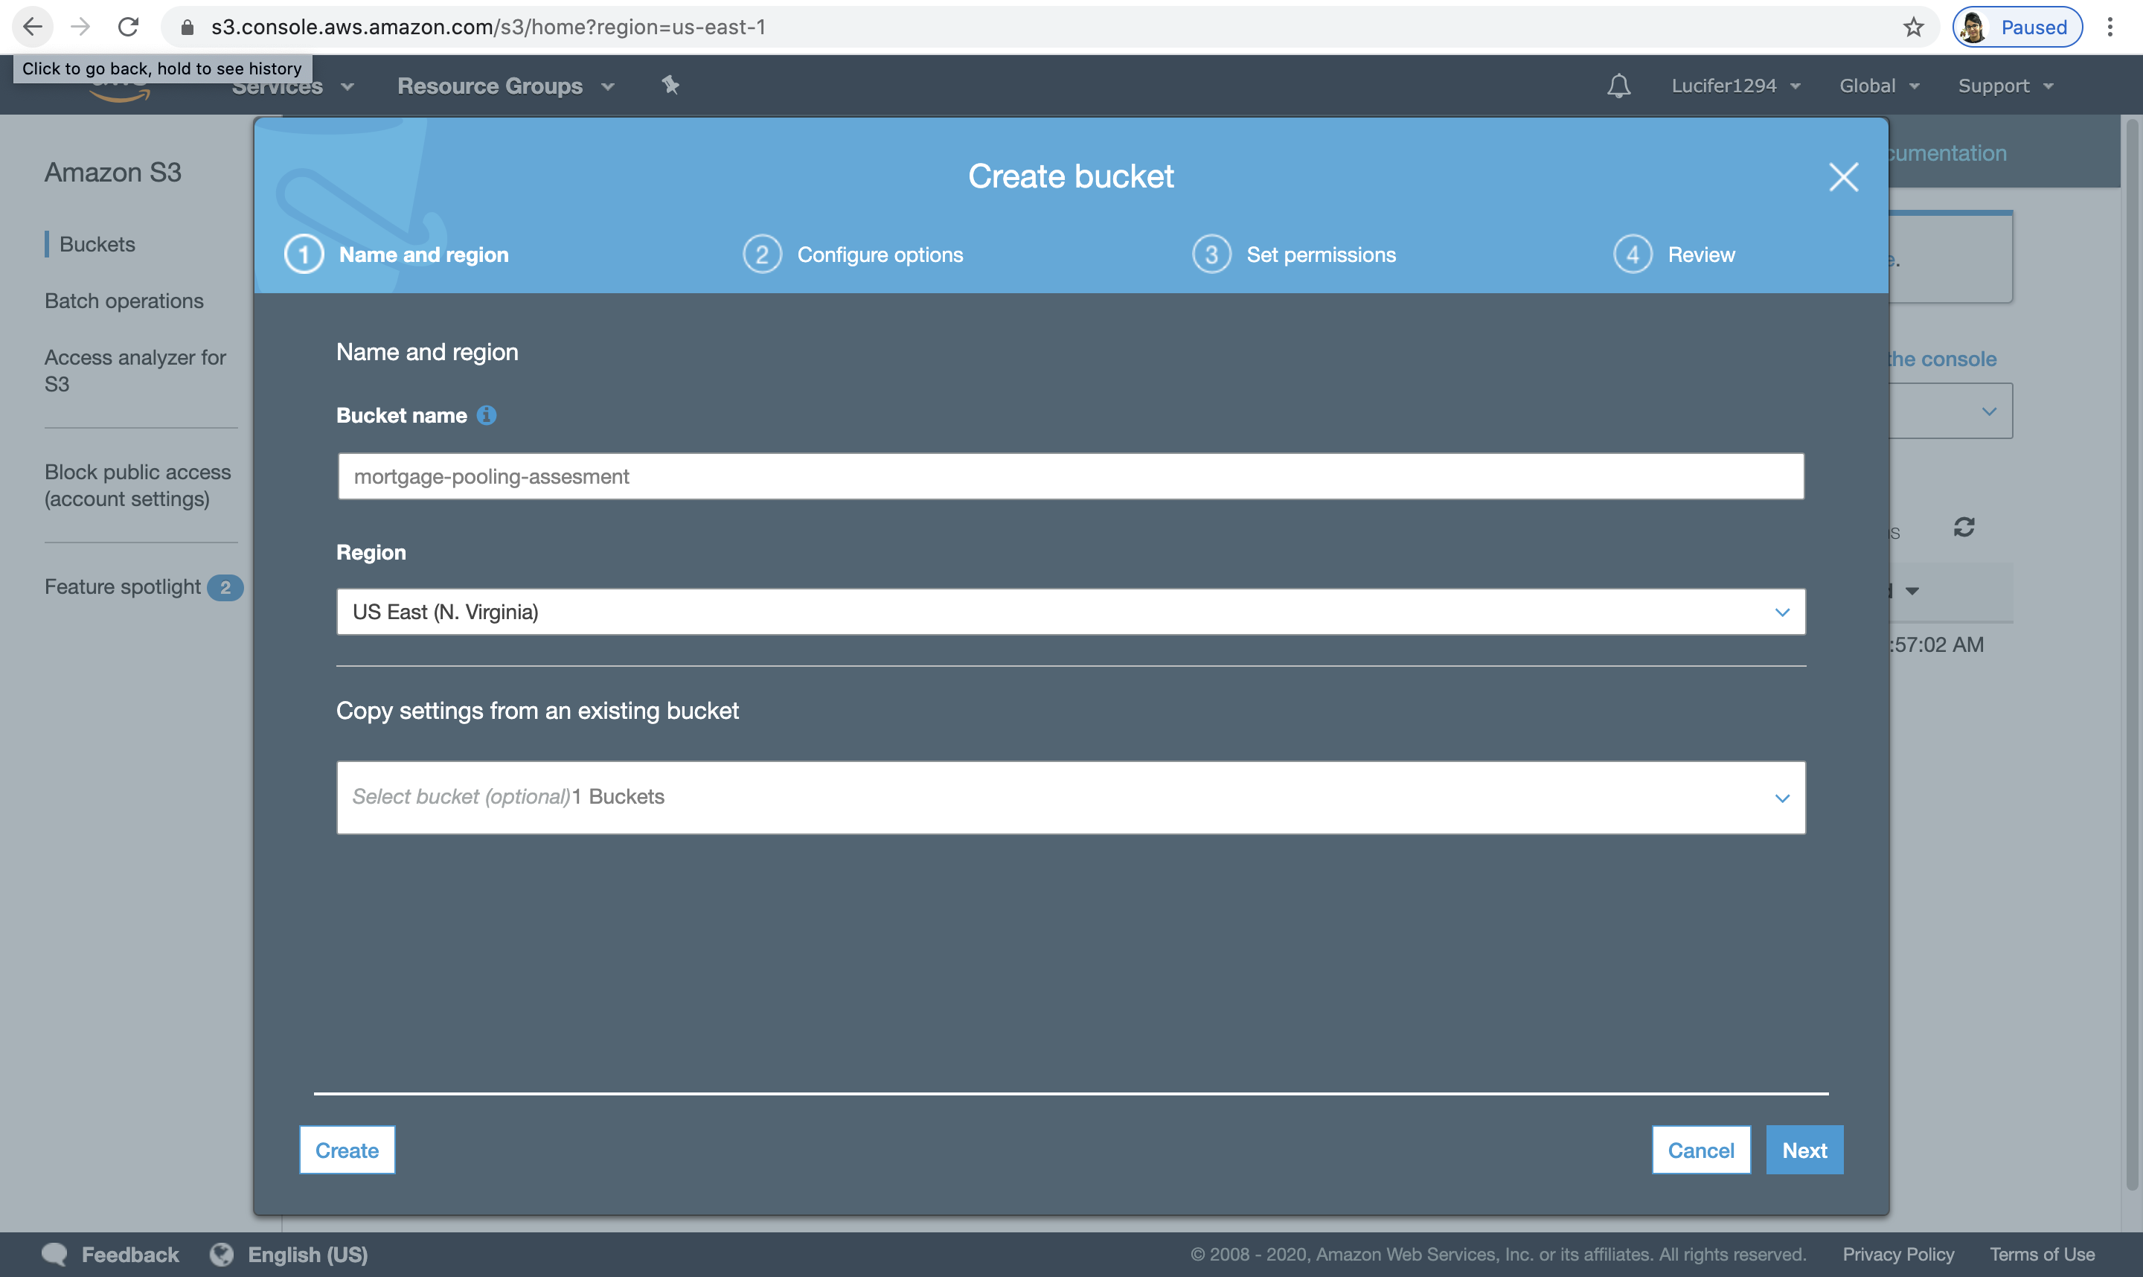
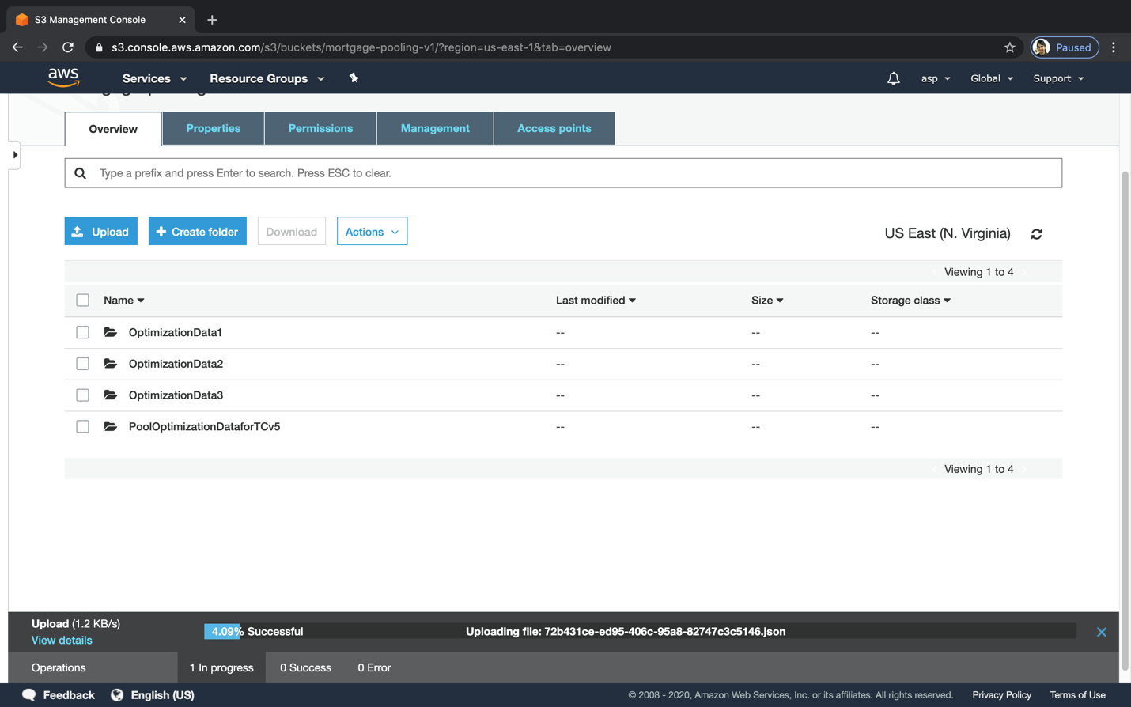
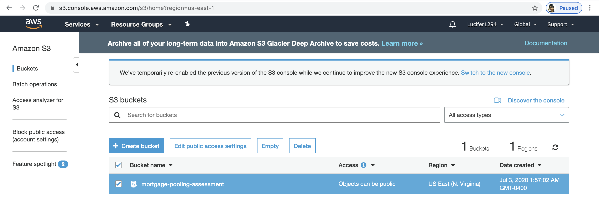
Step 2:
Creating bucket named as mortgage-pooling-assessment and uploading data on S3 Standard(free).

Slide 23
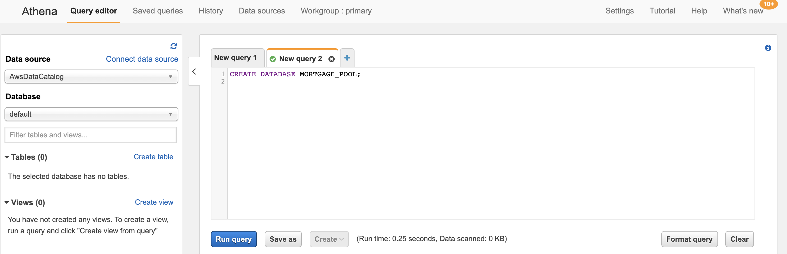
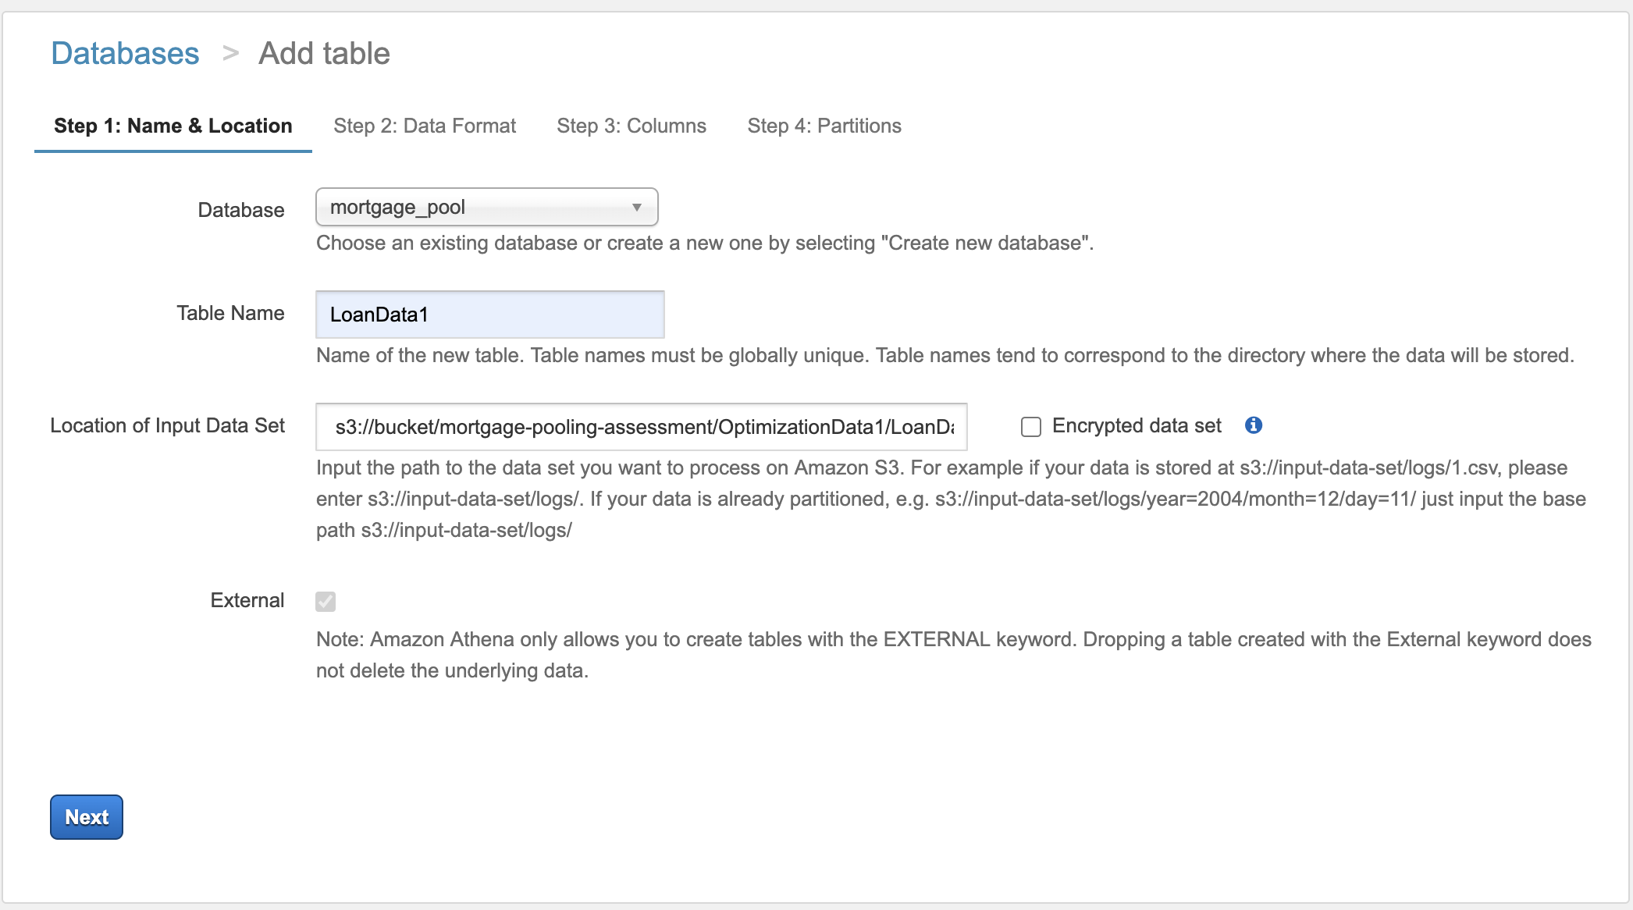
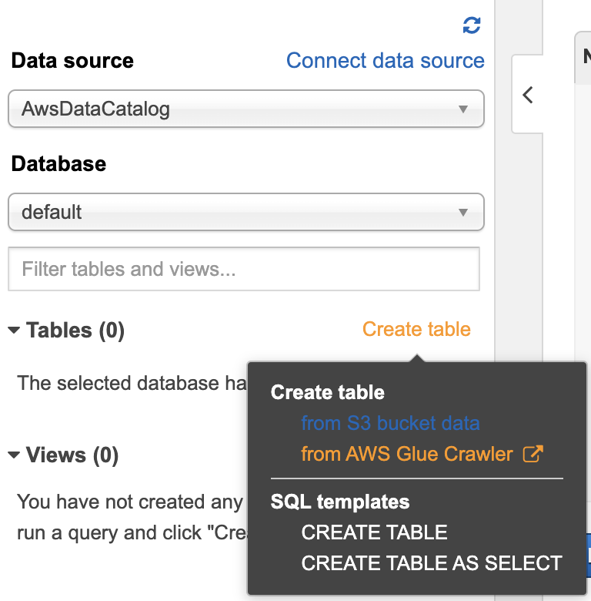
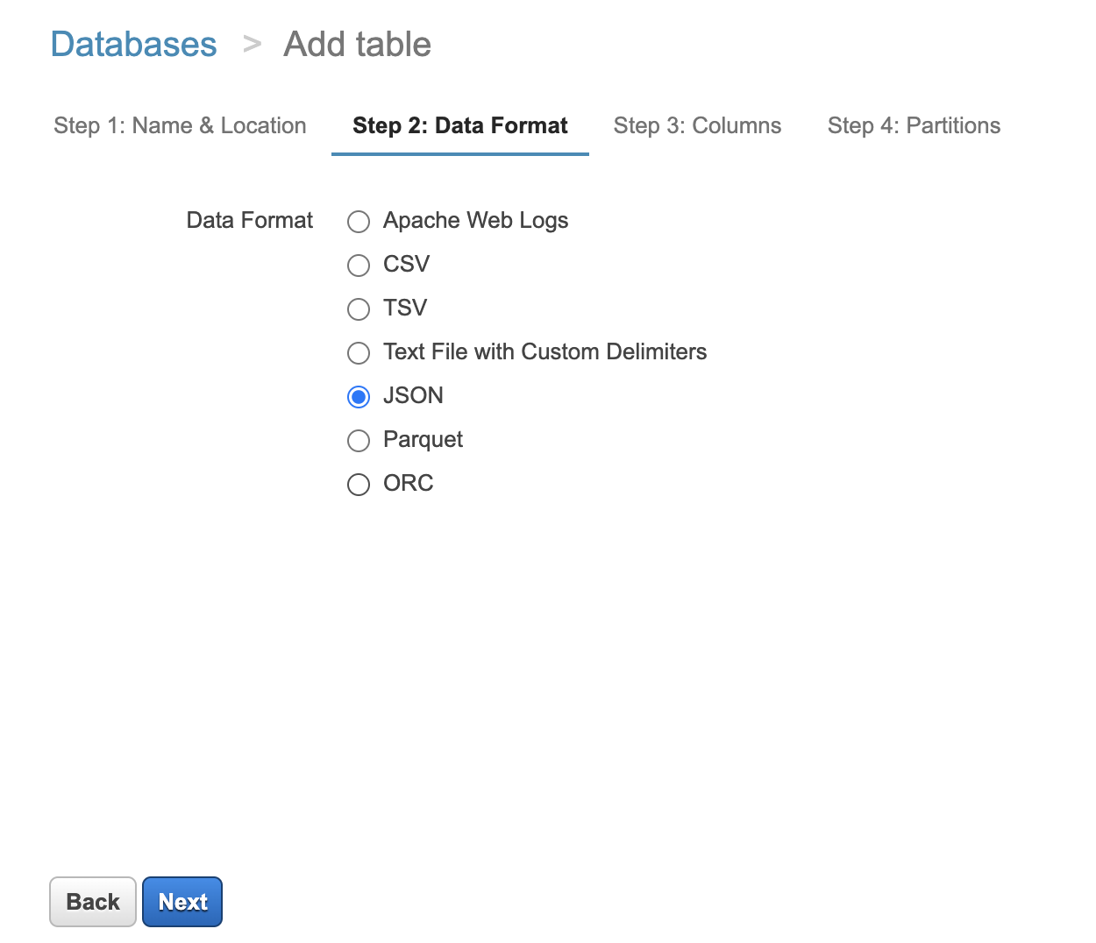
Step 3:
AWS Athena
Creating database mortgage and tables for each folder given in the dataset.

Slide 24
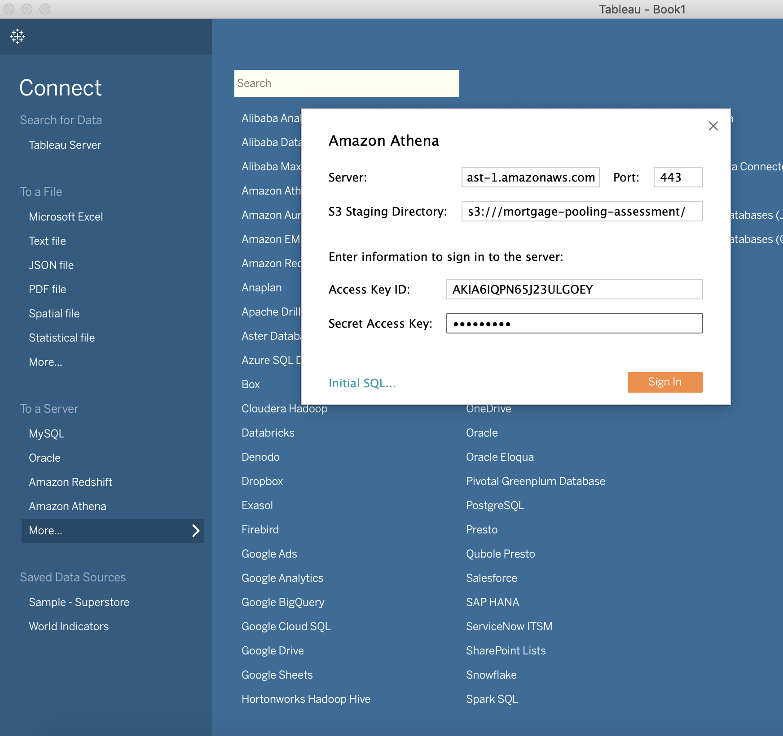
Step 4:
BI Tool Tableau
Connect to AWS Athena. JDBC driver should be present in the system.

Slide 25
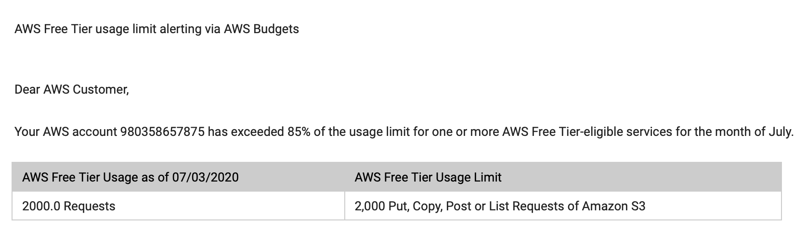
Unfortunately, AWS provides only 2,000 Request for S3. We had several JSON files which could not be uploaded on S3.
So used python to extract json files into database and exporting to excel.
Reading, extracting and transformation steps done in python mentioned in pdf. Also attached python jupyter notebook

